Slide 1
Kazakhstan CleanTech Revolution

Slide 2
The Need
Almaty is one of the most polluted cities in the world!
85% due to urban traffic
Public awareness grows
UN program (UNDP CAST)
Euro IV regulation on any new car from Jan. 2014
Kazakh people love their cars.

Slide 3
The Solution – Natural Gas Vehicles
Many programs to deploy NG stations in Almaty.
Intended mostly for busses and taxi.
The real goal: private cars
People want:
Cheap and reliable cars.
Cheap gas.

Slide 4
How Natural Gas Vehicles Work?
Natural Gas Vehicles (NGV) use the same basic principles as gasoline powered vehicles.
The difference is the fuel – Natural Gas instead of Gasoline.
In order to use NGV – an additional system must be installed in the vehicle.
Any car can be converted to run on natural gas.

Slide 5
NG Conversion – In 3 Easy Steps
Buy Natural Gas system for your car.
Hire a certified installer to install the system in the vehicle.
Enjoy driving on natural gas in Kazakhstan.

Slide 6
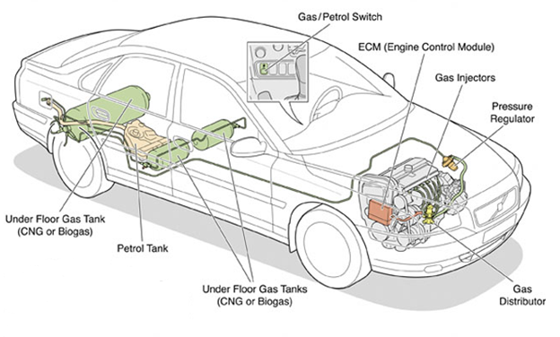
NGV system scheme

Slide 7
The Natural Gas Tank
Natural Gas is held in a fuel tank, compressed to 3000 – 3600 psi.
The tank is additional to the original petrol tank.

Slide 8
Pressure Regulator
Converts the gas pressure from 3000-3600 psi to around 125 psi.
Gas injectors then inject the gas and together with the air creates the spark to move the vehicle.

Slide 9
Additional Parts
Electronic Control Module
Controls the NG system.
Gas / Petrol Switch
Driver choose between gas or petrol manually.

Slide 10
The Next Steps (In Parallel)
Marketing Research.
Initiation of the project in Kazakhstan.

Slide 11
Project Plan
Marketing Research
Find NG conversion kit
Build a prototype
Start Mass Production
Find installer

Slide 12
Marketing Research
We would like to learn the following:
Determine the potential market depth of conversion to NGV in Almaty.
Sellers market analysis:
Conversion price.
Maintenance price. Is there warranty?
What conversion kits are being used today?

Slide 13
NGV system scheme

